Slide 1


Slide 2
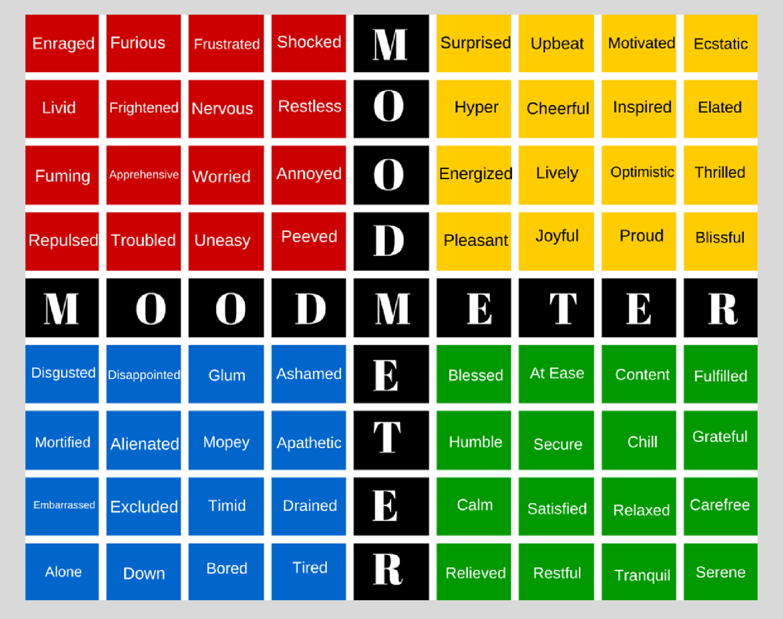
Starter task:
Using the mood meter identify what colour or feeling you are right now.
Where do you feel it in your body?

Slide 3

Learning Intention: Today we are beginning our learning about the commandments.
Success Criteria:
By the end of the lesson I will be able to:
. Understand what the commandments are and the history behind them.

Slide 4
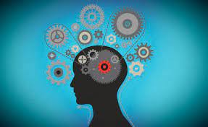
“Beliefs about God are the most significant of all Jewish beliefs.”
How far do you agree? 20 marks (2019)

Slide 5
Judaism
Beliefs
• beliefs about God
• nature of human beings: yetzer tov; yetzer harah; free will; suffering
• beliefs about Covenant
• judgement; the Messiah; the Messianic Age; Olam Ha’ba
Practices
• living according to the Commandments
• Rosh Hashanah; Yom Kippur
• worship: Shabbat; synagogue

Slide 6
What does the word practice mean?
The actual application or use of an idea, belief, or method, as opposed to theories relating to it
Action rather than thought or ideas.
PrACTice

Slide 7
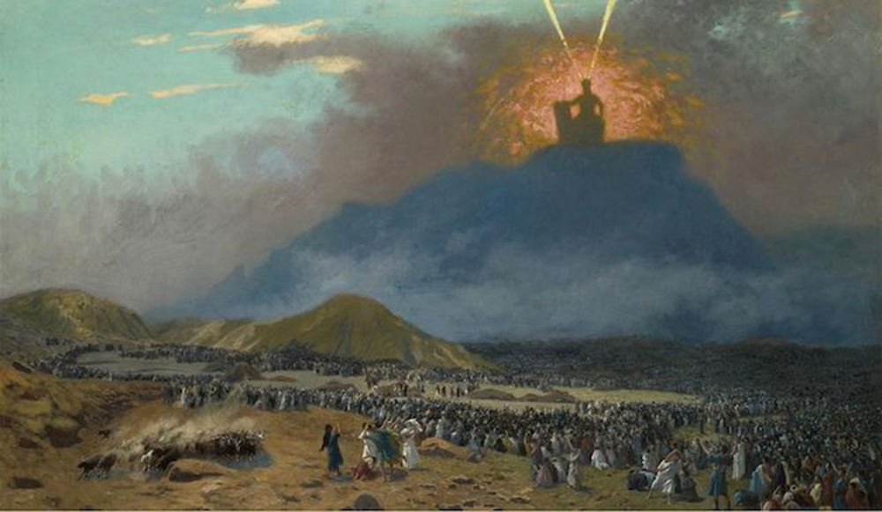
3.10.22 The commandments
God spoke to Moses and gave him a set of rules to show the Jewish people how to live correctly.

Slide 8
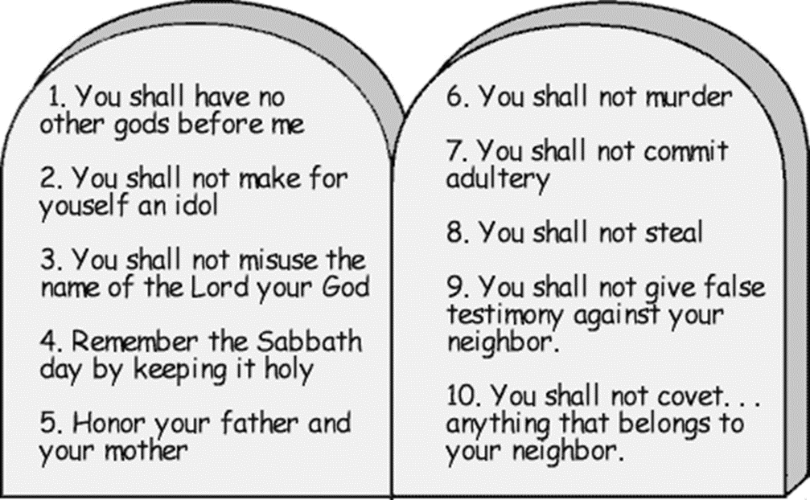
Stick the 10 commandments into your jotter
Put a next to the ones you think are still important and a ? next to any that you are unclear about.

Slide 9

The Two Tablets are divided into two categories.
Duties to God (1-5) and Duties to People (6-10)
Judaism teaches that the first tablet, containing the first five declarations, identifies duties regarding our relationship with God, while the second tablet, containing the last five declarations, identifies duties regarding our relationship with other people.
Duties to God
Duties to people.

Slide 10
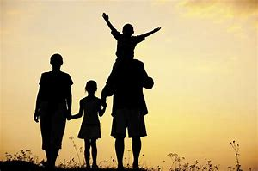

You may have noticed, however, that the fifth category, which is included in the first tablet, is the category to honour father and mother, which would seem to concern relationships between people.
The rabbis teach that our parents are our creators and stand in a relationship to us akin to our relationship to the divine.
These two tablets are parallel and equal: duties to God are not more important than duties to people, nor are duties to people more important than duties to God.

Slide 11
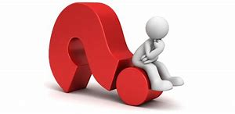
The two tablets or "Ten Commandments," are believed to be the words that the Creator Himself wrote on the two stone tablets that Moses brought down from Mount Sinai (Ex. 31:18).
Interestingly in the Torah, these words are never referred to as the Ten Commandments!
In rabbinical texts, they are referred to as Aseret ha-Dibrot, meaning word, speak or thing; thus, the phrase is accurately translated as the “the ten Sayings or ten Statements or ten declarations, or even the ten things” but not as the Ten Commandments.
Whyy?

Slide 12
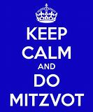
According to Jewish tradition, God gave the Jewish people 613 mitzvot (commandments).
All 613 of those mitzvot are equally sacred, equally binding and equally the word of God. 248 positives: You shall and 365 negatives: You shall not.
All of these mitzvot are treated as equally important, because human beings, with our limited understanding of the universe, have no way of knowing which mitzvot are more important in the eyes of the Creator.
One Jewish text teaches "Be as meticulous in performing a 'minor' mitzvah as you are with a 'major' one, because you don't know what kind of reward you'll get for various mitzvot."

Slide 13
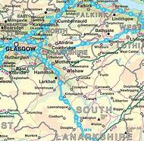
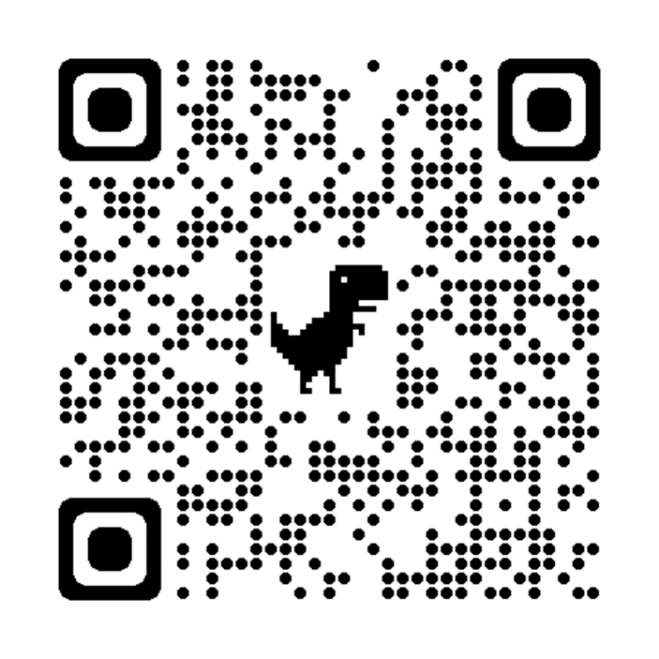
They encompass all aspects of daily life and, if followed, build a better person and a harmonious society.
“Our journey through life is an exciting yet hazardous experience. The greatest danger we face is to travel without a map. The key to navigate every step of the way and to successfully arrive at our destination, it is essential that we read, study and understand the map’s instructions and symbols.
Torah is the “map of life” whose laws are the 613 Commandments.”
https://torah.org/series/livinglaw/

Slide 14
Conclusion:
Make sure you have answered the question.
Use the wording of the question.
Focus on evaluation.
In conclusion I strongly agree that beliefs about God are the most significant of all Jewish belief. As I have shown in my essay these beliefs are very important to Jews and I believe they influence everything else within Judaism. Knowing who God is and what he can do explains the other aspects of their faith and shapes all Jewish practice, therefore I think it is the most significant of all Jewish beliefs.
“Beliefs about God are the most significant of all Jewish beliefs.”
How far do you agree? 20 marks (2019)

Slide 15
“Our journey through life is an exciting yet hazardous experience. The greatest danger we face is to travel without a map. The key to navigate every step of the way and to successfully arrive at our destination, it is essential that we read, study and understand the map’s instructions and symbols.
Torah is the “map of life” whose laws are the 613 Commandments.”
https://torah.org/series/livinglaw/

Slide 16
Task:
Create a table that looks like this.
Find out about 5 Mitzvot and fill in the chart as shown.
For each one consider how would following that Mitzvot practically impact a Jew today.
Mitzvot | Book of Torah (source) | Explain | Impact on Jew today

Slide 17
To learn Torah and teach it— Deut 6:7
Respect your father and mother—Exodus 20:12
To serve the Almighty with prayer daily— Ex 23:25
Not to eat non-kosher animals— Lev 11:4
Not to insult or harm anybody with words— Lev 25:17
Not to have homosexual sexual relations— Lev 18:22
Not to put a stumbling block before a blind man (nor give harmful advice)– Lev 19: 14

